Slide 1
Star Emporium
prepared by:-
1032111600422 Avrodeep Pal (4231303-33022)
1032111100438 Indrasish Biswas (4231303-33026)
1032111400455 Snehargha Mukherjee (4231303-33013)
1032111100462 Tamonash Sarkar (4231303-33015)

Slide 2




Bookmarks Birds
Once you learn to read, you will be forever free.
– Frederick Douglass
A book is a gift you can open again
and again.
– Garrison Keillor
Never put off till tomorrow the book you can read today.
– Holbrook Jackson
Reading for me, is spending time
with a friend.
– Gary Paulsen

Slide 3
E-Books
Books are closest to our hearts.
Trees are no-where afar.
Q: Is there a way, to not sacrifice one for other?
A: Read an E-Book!

Slide 4

visit Star Emporium!
The Ultimate eBook Store for Learners!!!

Slide 5
Introducing…
Our software specialities.

Slide 6
Why would you choose our Software?
Option 1: Enhanced User Interface and Experience
Option 2: Effortless Administrative Management
Option 3: Diverse Section of Options and Books
Option 4: Exceptionally Competitive Book Prices
Option 5: Robust Privacy and Security
Hint: All of the above.

Slide 7
Presenting…
Our Design and Analysis Aspects.

Slide 8
SRS (Software Requirements Specifications)
Functional Requirements :-
Non-Functional Requirements :-
User Management
Emporium Management
Book Search and Filtering
Cart Management
Payment Processing
Profile Management
Ebook Reading
Polished Performance
Security and Privacy
Scalability, Usability and Accessibility
Reliability and Avalibility
Integration and Compliance

Slide 9
About the Software
Software Requirements :-
Hardware Requirements :-
Java (Netbeans)
platform-independent, customizations, interfaces, easy integration, effective development
MySQL
Open-Source, RDBMS, ACID compliance, scalability, reliability, user-friendly, robust, resourceful
64-bit Windows OS
i3-2100 or newer
4GB RAM
10GB storage (recommended)

Slide 10
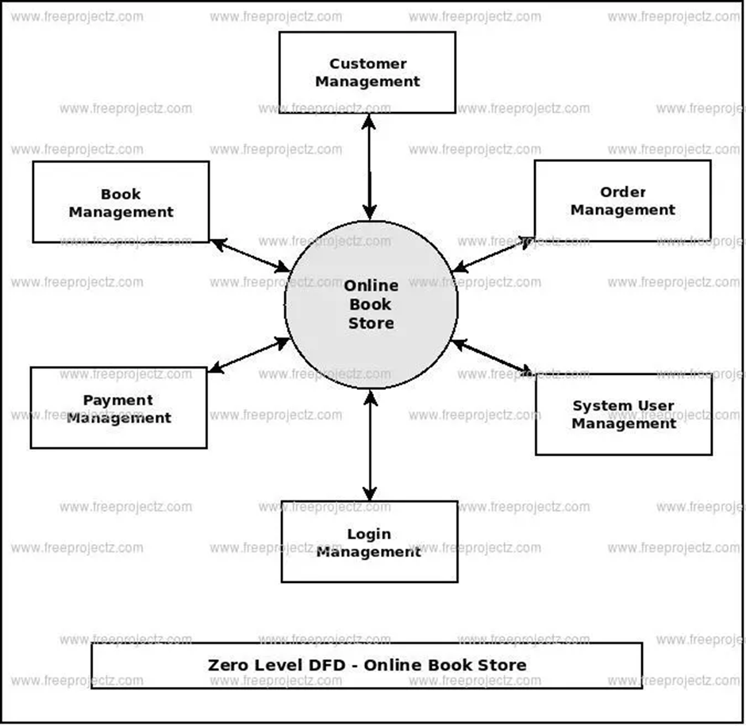
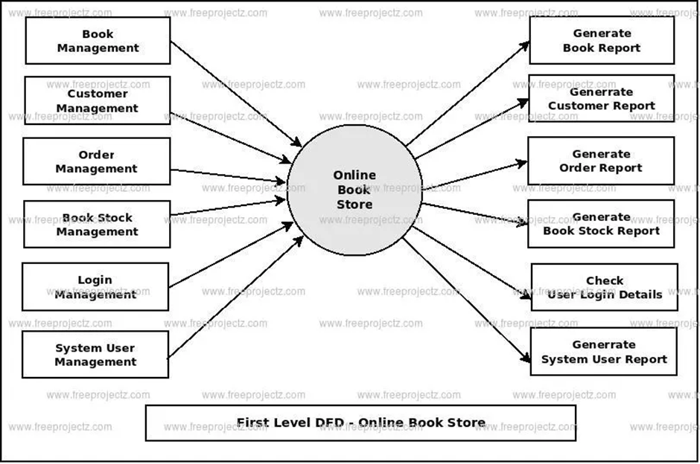
DFD (Data Flow Diagram)

Slide 11
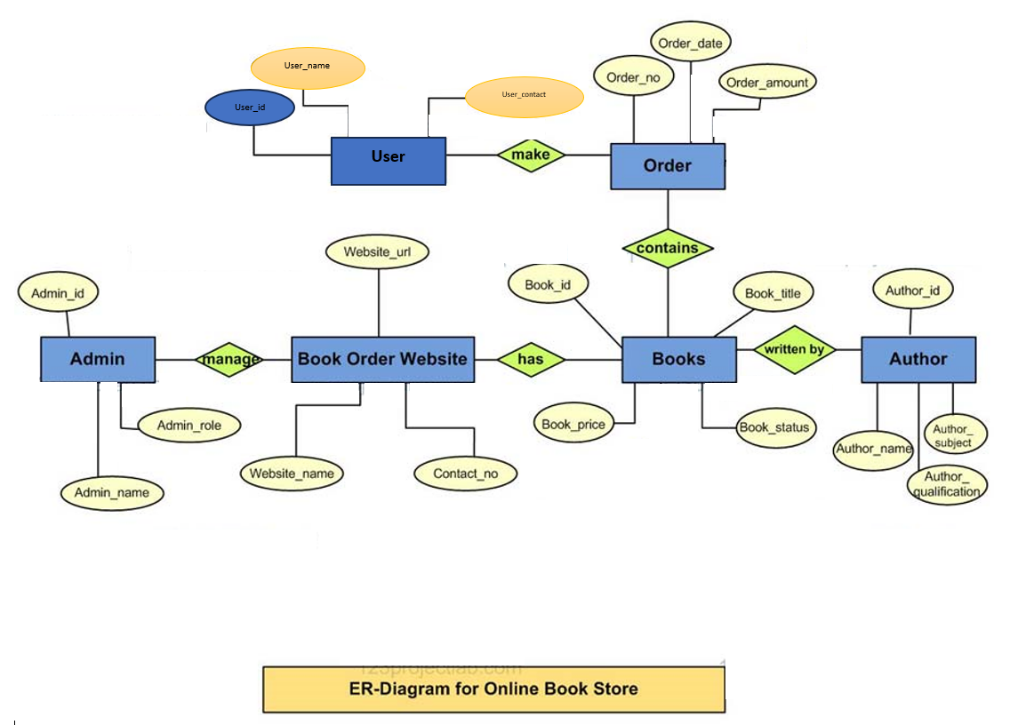
ERD (Entity Relationship Diagram)

Slide 12
Concluding…
With our Future Prospects and Best Wishes.

Slide 13
Promising Future Updates
Integration of AI and ML
Diverse Case Studies
More updated User Experience
Ecosystem Integration
Global Market Analysis
Security Patches and Updates
Performance Optimization

Slide 14
Closing Remarks
This software stands peerless among other ebook applications.
Excellent inventory management and real-time analysis.
Optimization that makes sure every person and computer have no complaints.
Join the digital community and explore countless benefits in your interests.
With promised updates and betterment of what is already subline, our Star Emporium is perfect for adoption into mainstream.

Slide 15
Thank You

